Slide 1
Principles of AI Engineering Chapter 7: Ethics, Fairness, and Transparency
Prof. Dr. Steffen Herbold
Credit:
Based on contents from Christian Kästner (https://github.com/ckaestne/seai)

Slide 2
Contents
Ethics
Fairness
Sources of bias
Fairness definitions
Achieving fairness
Transparency
Accountability

Slide 3
Ethics
Notes:
(8 min)

Slide 4




Legal vs. Ethical
Legal
In accordance to societal laws
Systematic body of rules governing society, defined by the government
Punishment for violation
Ethical
Following moral principles of traditions, groups, or individuals
Branch of philosophy, science of a standard human conduct
Professional ethics are rules codified by a professional organization
E.g., ACM: https://www.acm.org/code-of-ethics
Not legally binding, (usually) no strict enforcement
High ethical standards may yield long-term benefits through image and staff locality

Slide 5
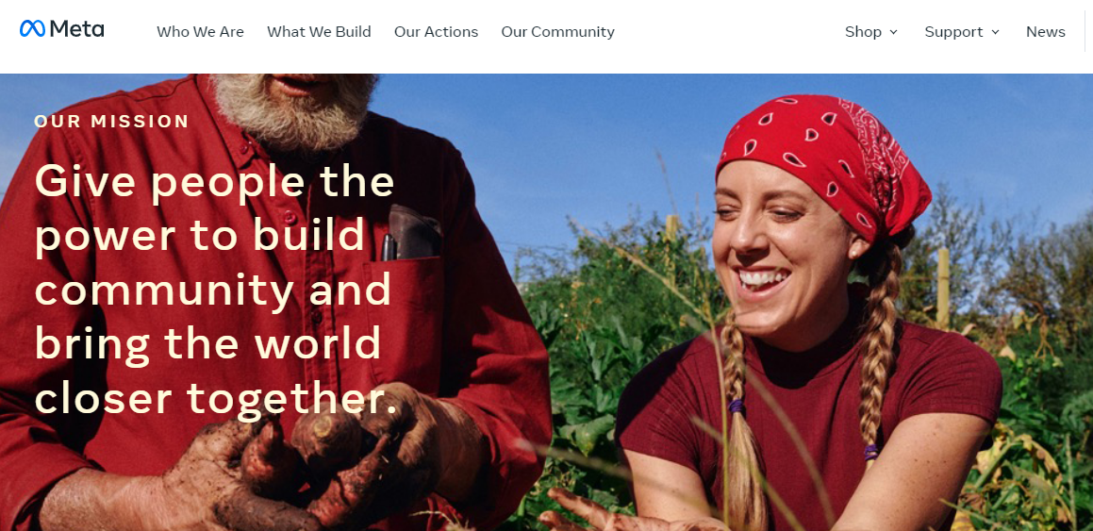
Example: Social Networks
Live exercise: What are the actual business objectives?
https://about.facebook.com/company-info

Slide 6

Social media business objectives
Monetize interactions with social media
This is certainly legal and not, in itself, unethical
How is monetization optimized?
User engagement!
https://commons.wikimedia.org/wiki/File:Social-media-g6e011fe56_1920.png

Slide 7
How to maximize user engagement
Infinite scroll
Page automatically extended with more content before reaching the bottom
No natural stopping point, e.g., by clicking on next page
Encourages non-stop, continual use
Personal recommendations
Suggest user content and news to increase engagement
Push notifications
Notify disengaged users to return to the app
New content, new social interactions (e.g., likes), …
Legal and even expected standard functions
(Missing this may lead to dissatisfied users!)

Slide 8
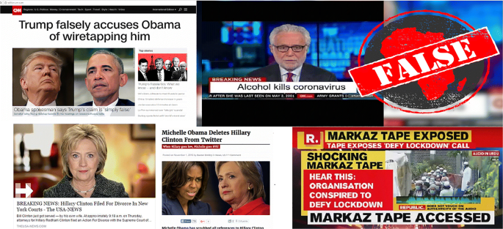
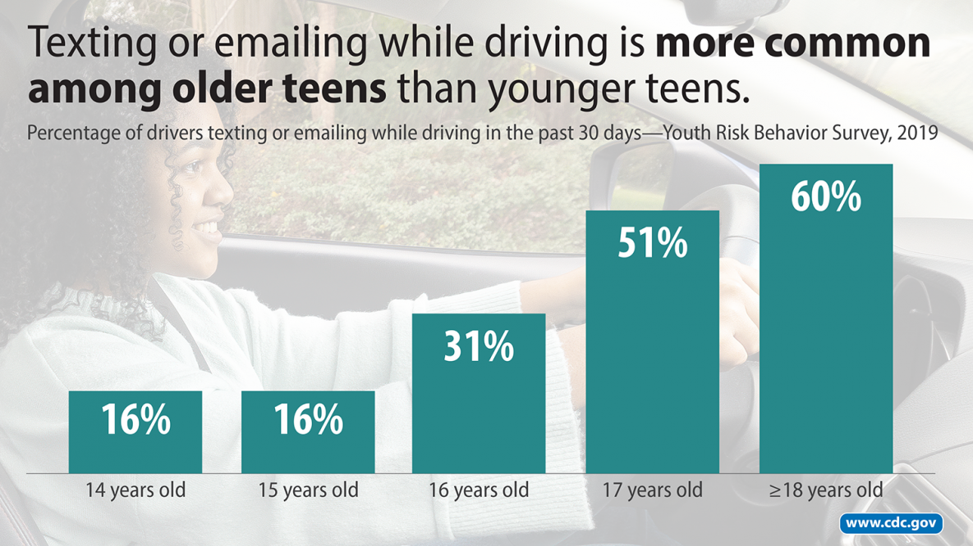
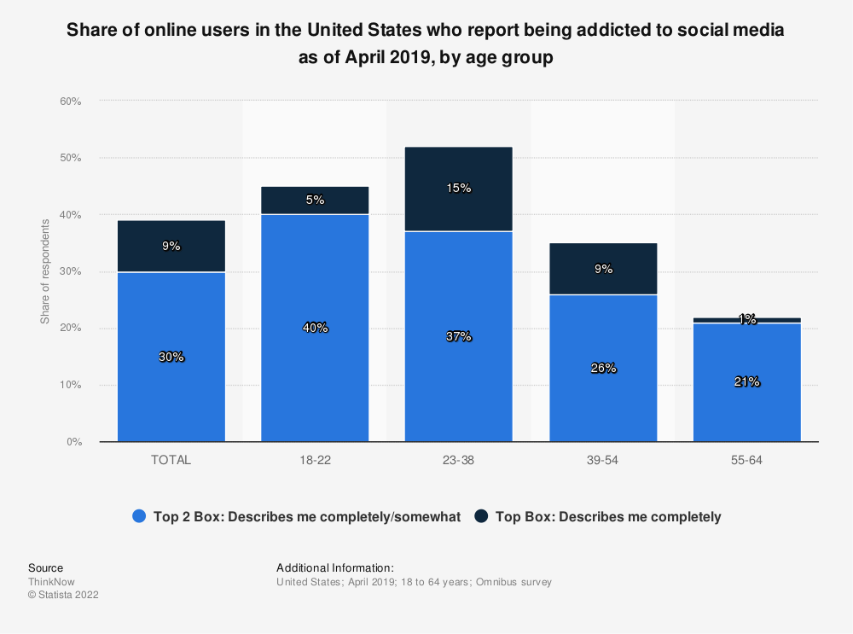
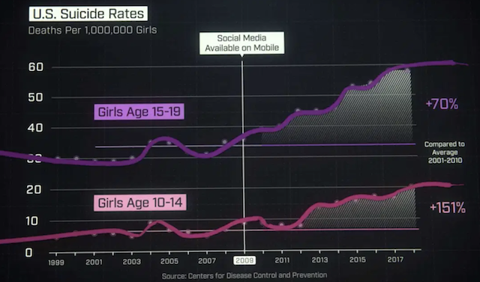
Negative side effects
Amplification of fake news
Facebook / https://doi.org/10.1007/s11042-020-10183-2
https://www.cdc.gov/mmwr/volumes/69/su/su6901a9.htm?s_cid=su6901a9_w
So is this ethical?
https://leftronic.com/blog/social-media-addiction-statistics/

Slide 9
Challenges
Misalignment between organizational goals and societal values
Financial incentives often dominate other goals
Insufficient amount of regulations
Little legal consequences for causing negative impact (there are exceptions!)
Poor understanding of social-technical systems by policy makers
Engineering challenges, both at system and ML level
Difficult to clearly define or measure ethical values
Difficult to predict possible usage contexts
Difficult to predict impact of feedback loops
Difficult to prevent malicious actors from abusing the system
Difficult to interpret output of ML and make ethical decision
…
Not new, but exacerbated by use of ML!

Slide 10
Fairness
Notes:
(8 min)

Slide 11
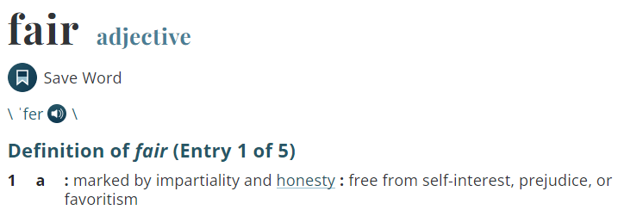
Definition
https://www.merriam-webster.com/dictionary/fair

Slide 12
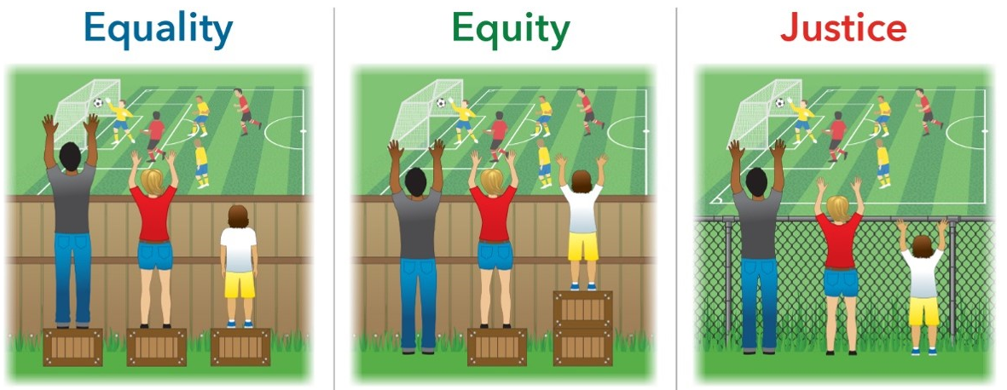
But which one is fair?!
Evenly distributed tools and assistance
Custom tools that identify and address inequality
Fixing the system to offer equal access to both tools and opportunities
… more on defining fairness later

Slide 13
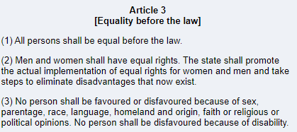
Legal fairness protections
German Basic Law (Grundgesetz)
USA based on various laws (e.g., Civil Rights Act, Equal Pay Act):
Race, color, sex, religion, national origin, citizenship, age, pregnancy, familial status, disability status, veteran status, genetic information
https://www.gesetze-im-internet.de/englisch_gg/englisch_gg.html#p0026
Sometimes regulated by specific laws and agencies: credit scoring, education, employment, …

Slide 14
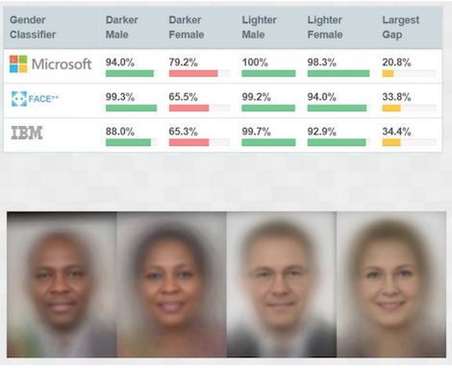
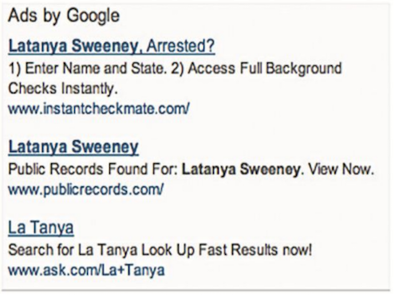
Types of harm on society due to unfairness
Harms of allocation
Withhold opportunities or resources
Harms of representation
Reinforce stereotypes, subordination along the lines of identity
Gender Shades: Intersectional Accuracy Disparities in Commercial Gender Classification, Buolamwini & Gebru, ACM FAT* (2018).
Discrimination in Online Ad Delivery, Latanya Sweeney, SSRN (2013).

Slide 15
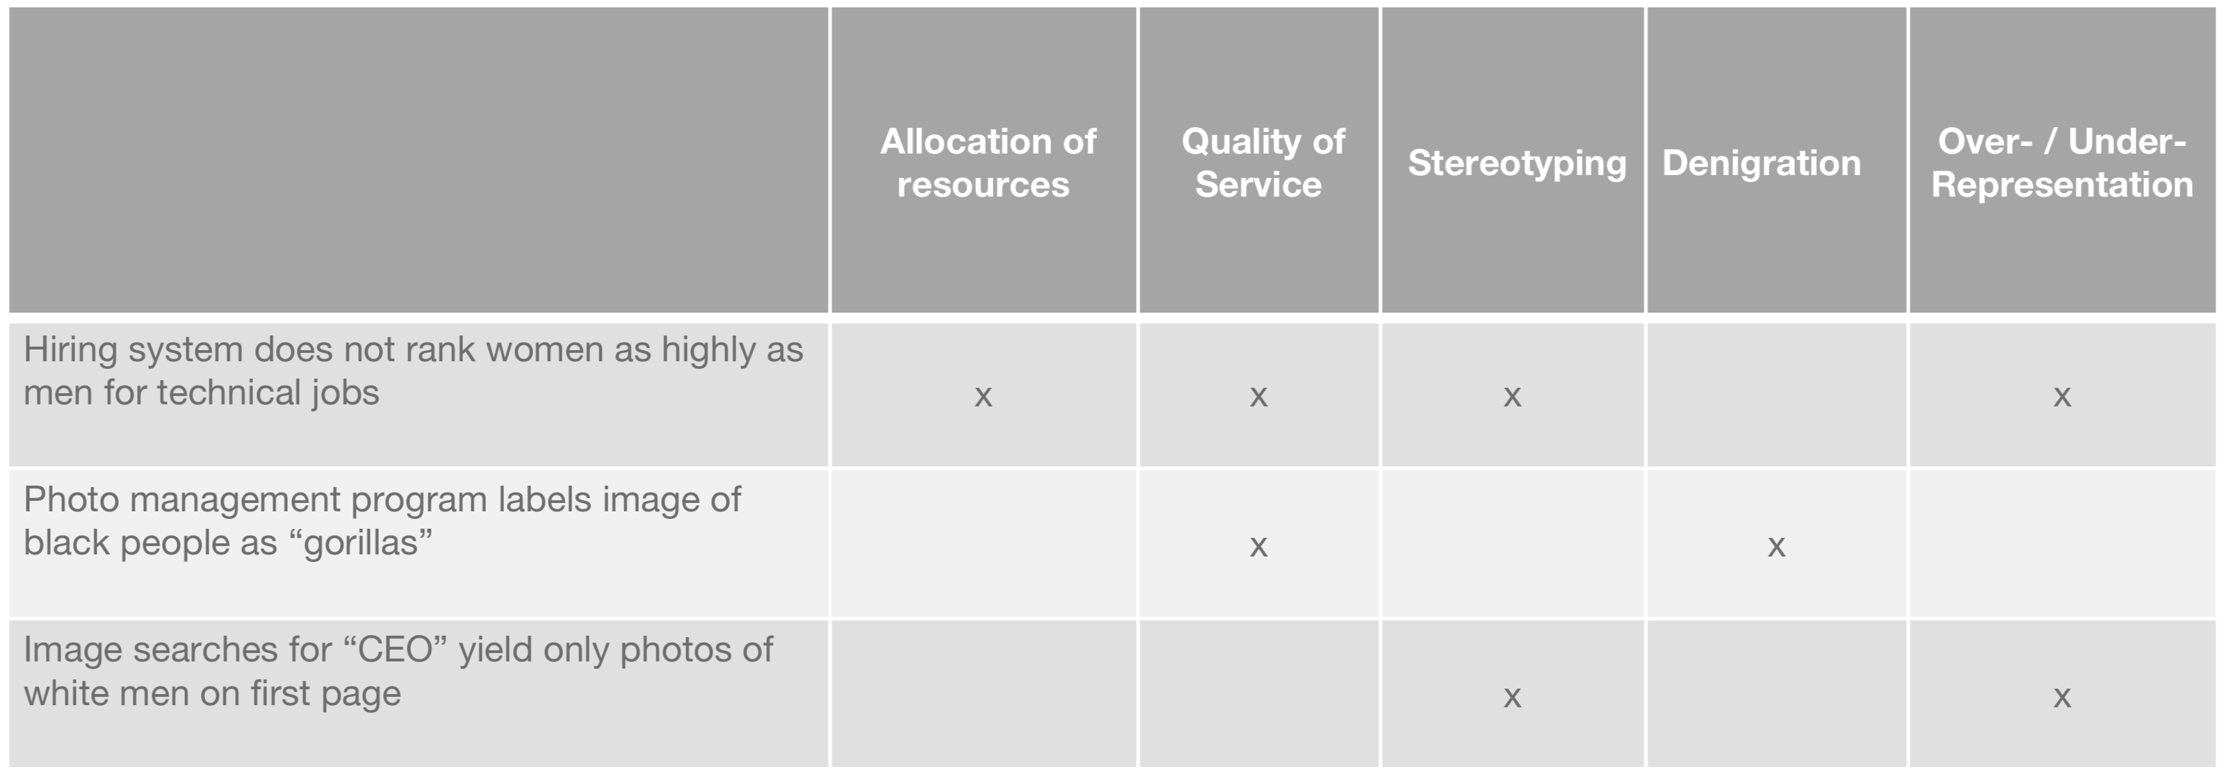
Identifying Harms
Products can cause multiple harms
Identify harms while considering system objectives!
Challenges of incorporating algorithmic fairness into practice, FAT* Tutorial (2019).

Slide 16
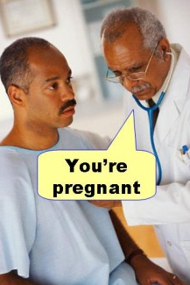
Not all discrimination is harmful
Medical diagnosis should take sex into account
The problem is unjustified discrimination, i.e., by factors that should not matter
Discrimination is a domain-specific concept and must be understood in the context of the problem domain!
Live exercise: What are other examples where discrimination is not harmful?

Slide 17
Sources of bias

Slide 18
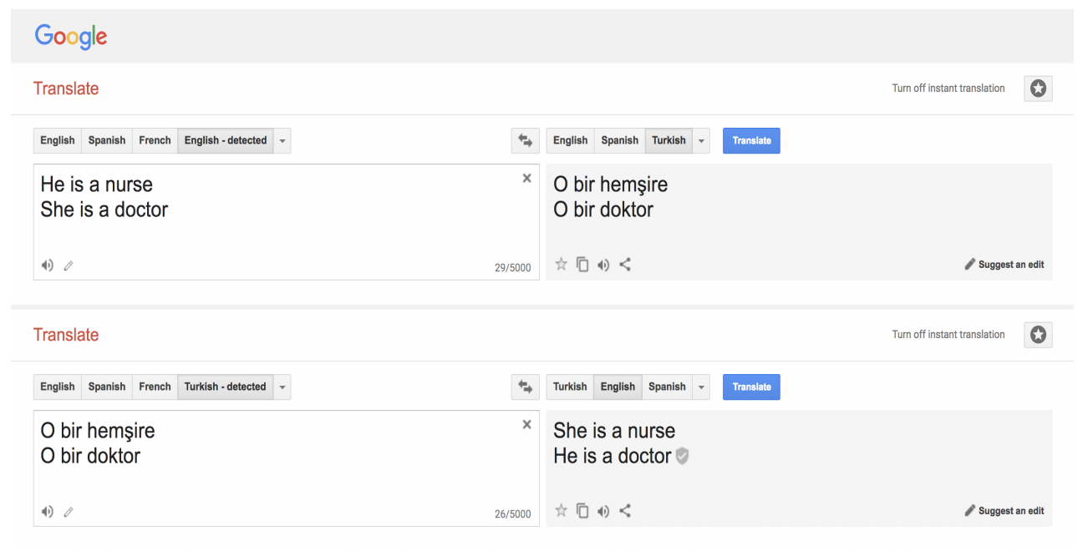
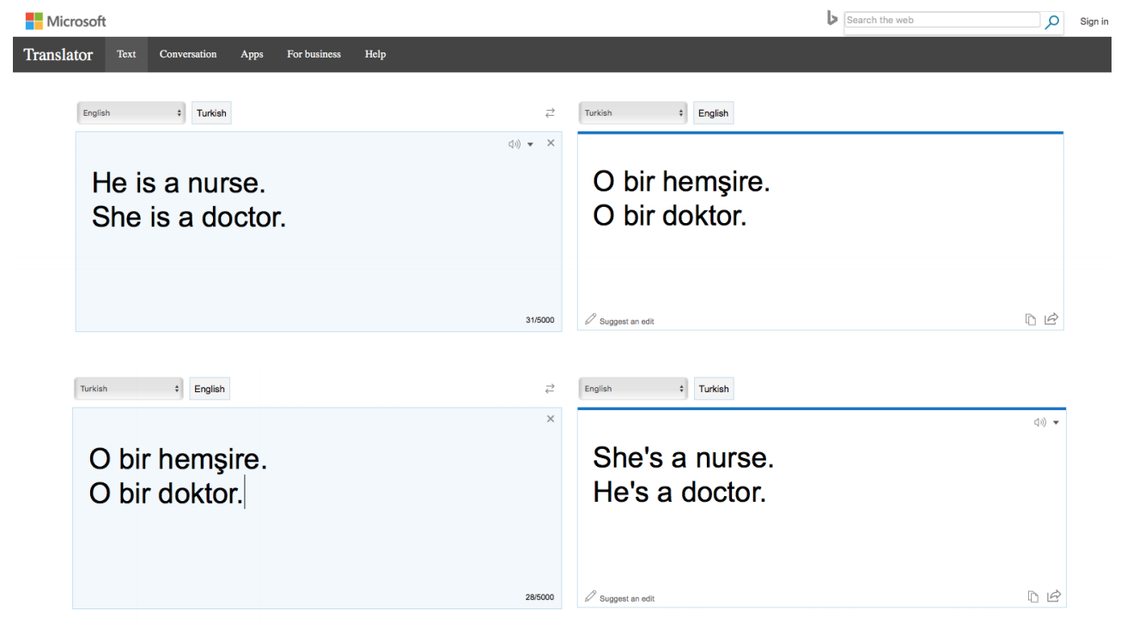
Bias is prevalent
Semantics derived automatically from language corpora contain human-like biases, Caliskan et al., Science (2017).

Slide 19
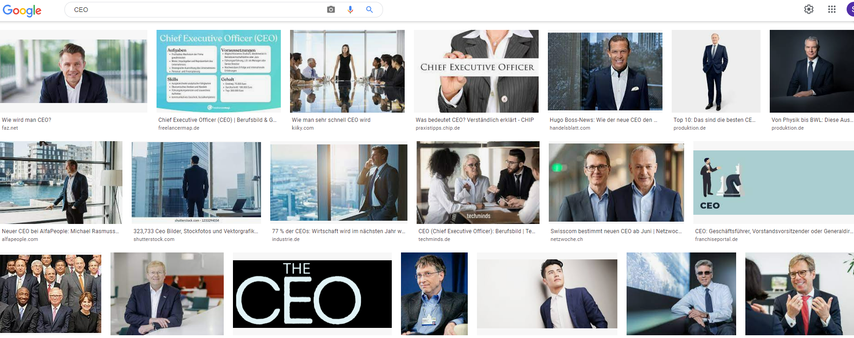
Historical bias
Data reflects past biases, not intended outcomes!

Slide 20
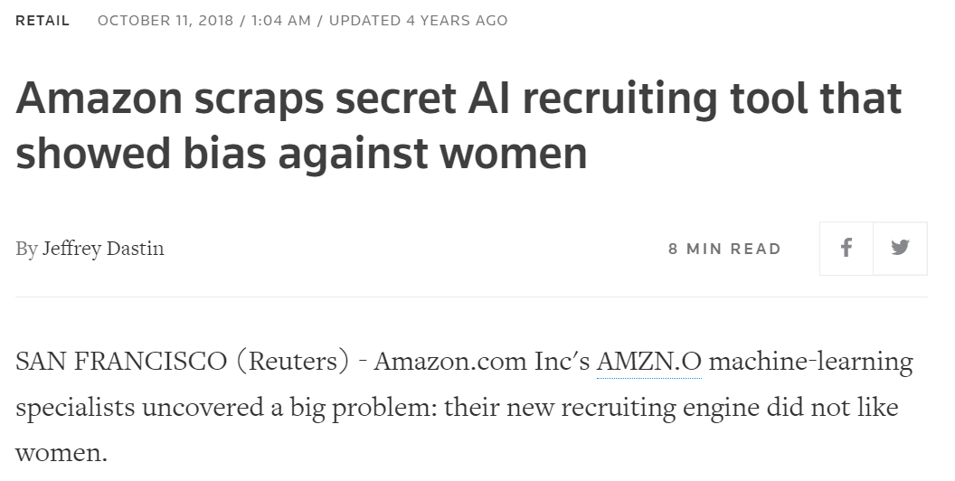
Tainted examples
Data tainted by biased examples, e.g., past hiring decisions which were biased in favor of man
https://www.reuters.com/article/us-amazon-com-jobs-automation-insight-idUSKCN1MK08G

Slide 21
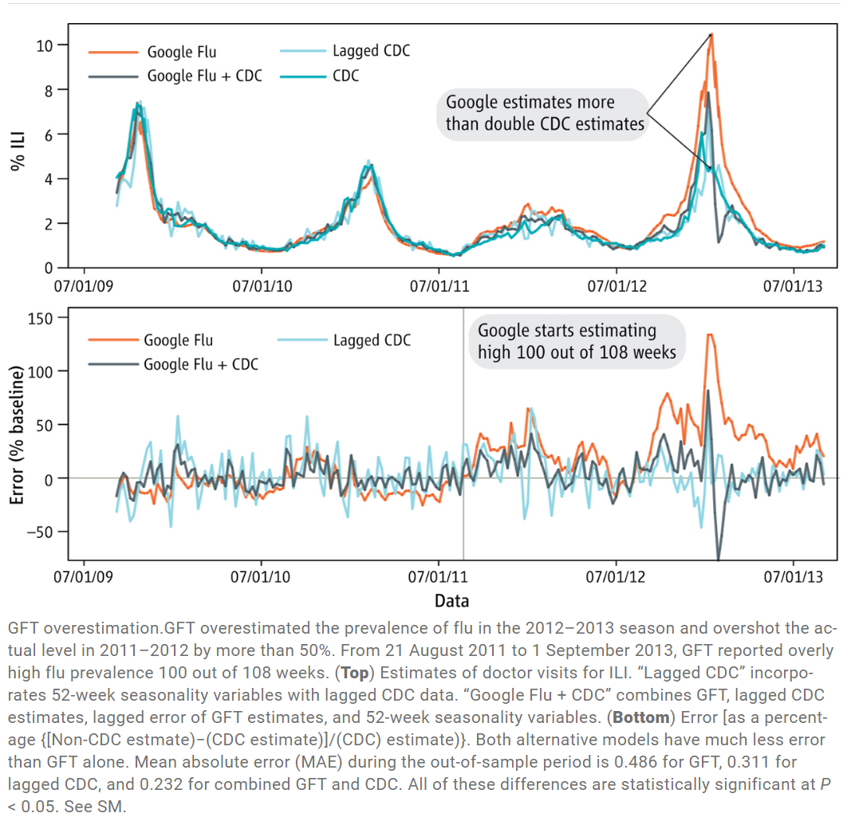
Skewed samples
Skewed samples may lead to overestimations
Flu model overestimates amount of flu, because it cannot distinguish between flu and flu-like illnesses
Lazer, David, et al. "The parable of Google Flu: traps in big data analysis." Science 343.6176 (2014): 1203-1205.

Slide 22
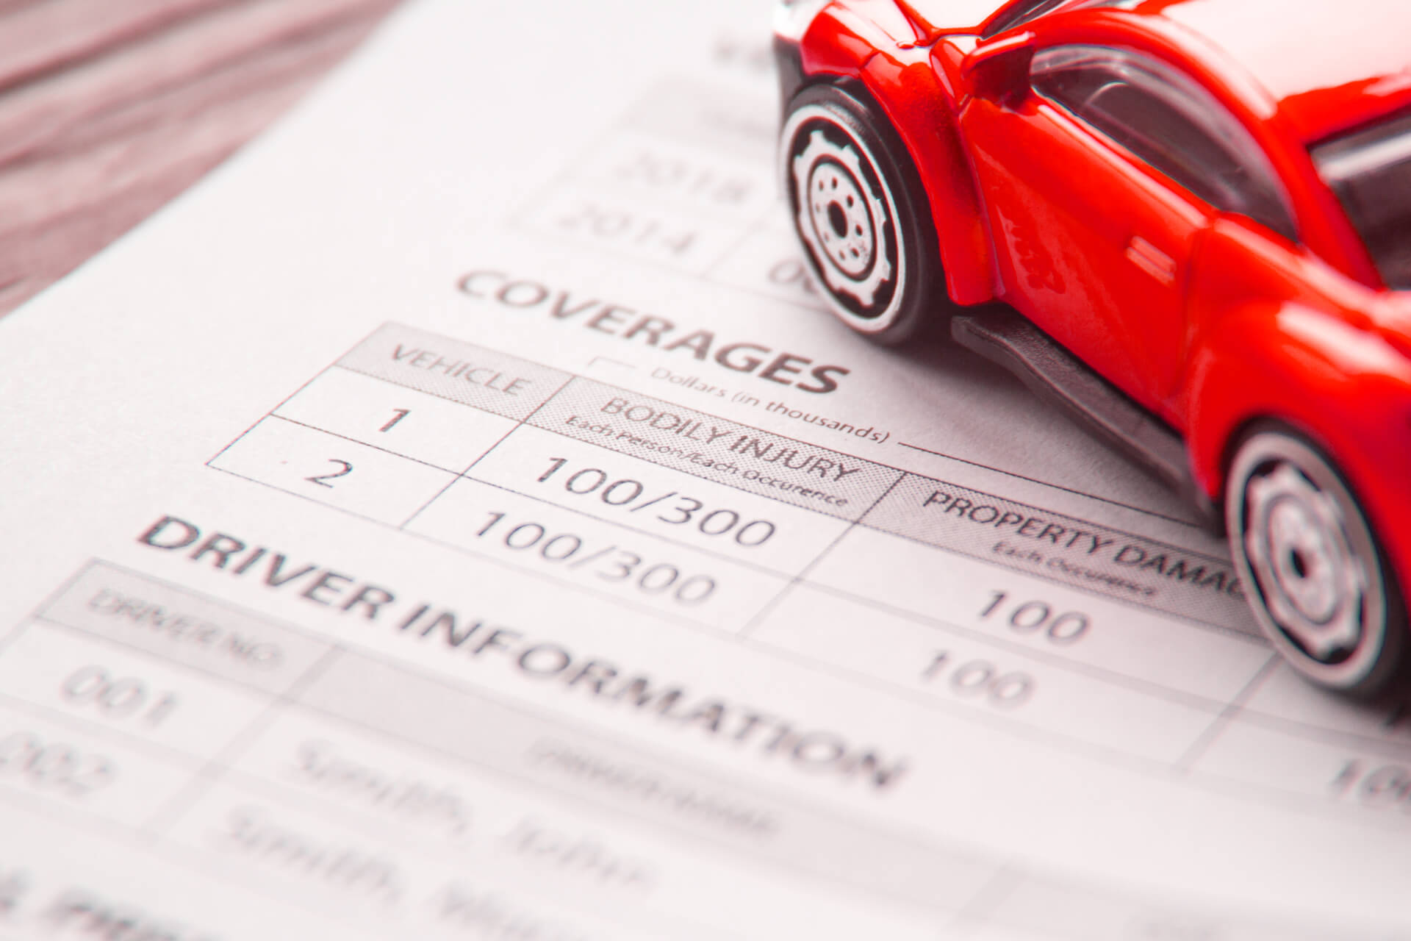
Limited features
Features may not be equally reliable for all parts of the data
Could lead to performance degradation for minorities
Example:
Car insurance based on average accidents for age group and region
Penalizes uncommonly safe drivers
https://www.quoteinspector.com/images/car-insurance/car-insurance-coverage-drivers/

Slide 23
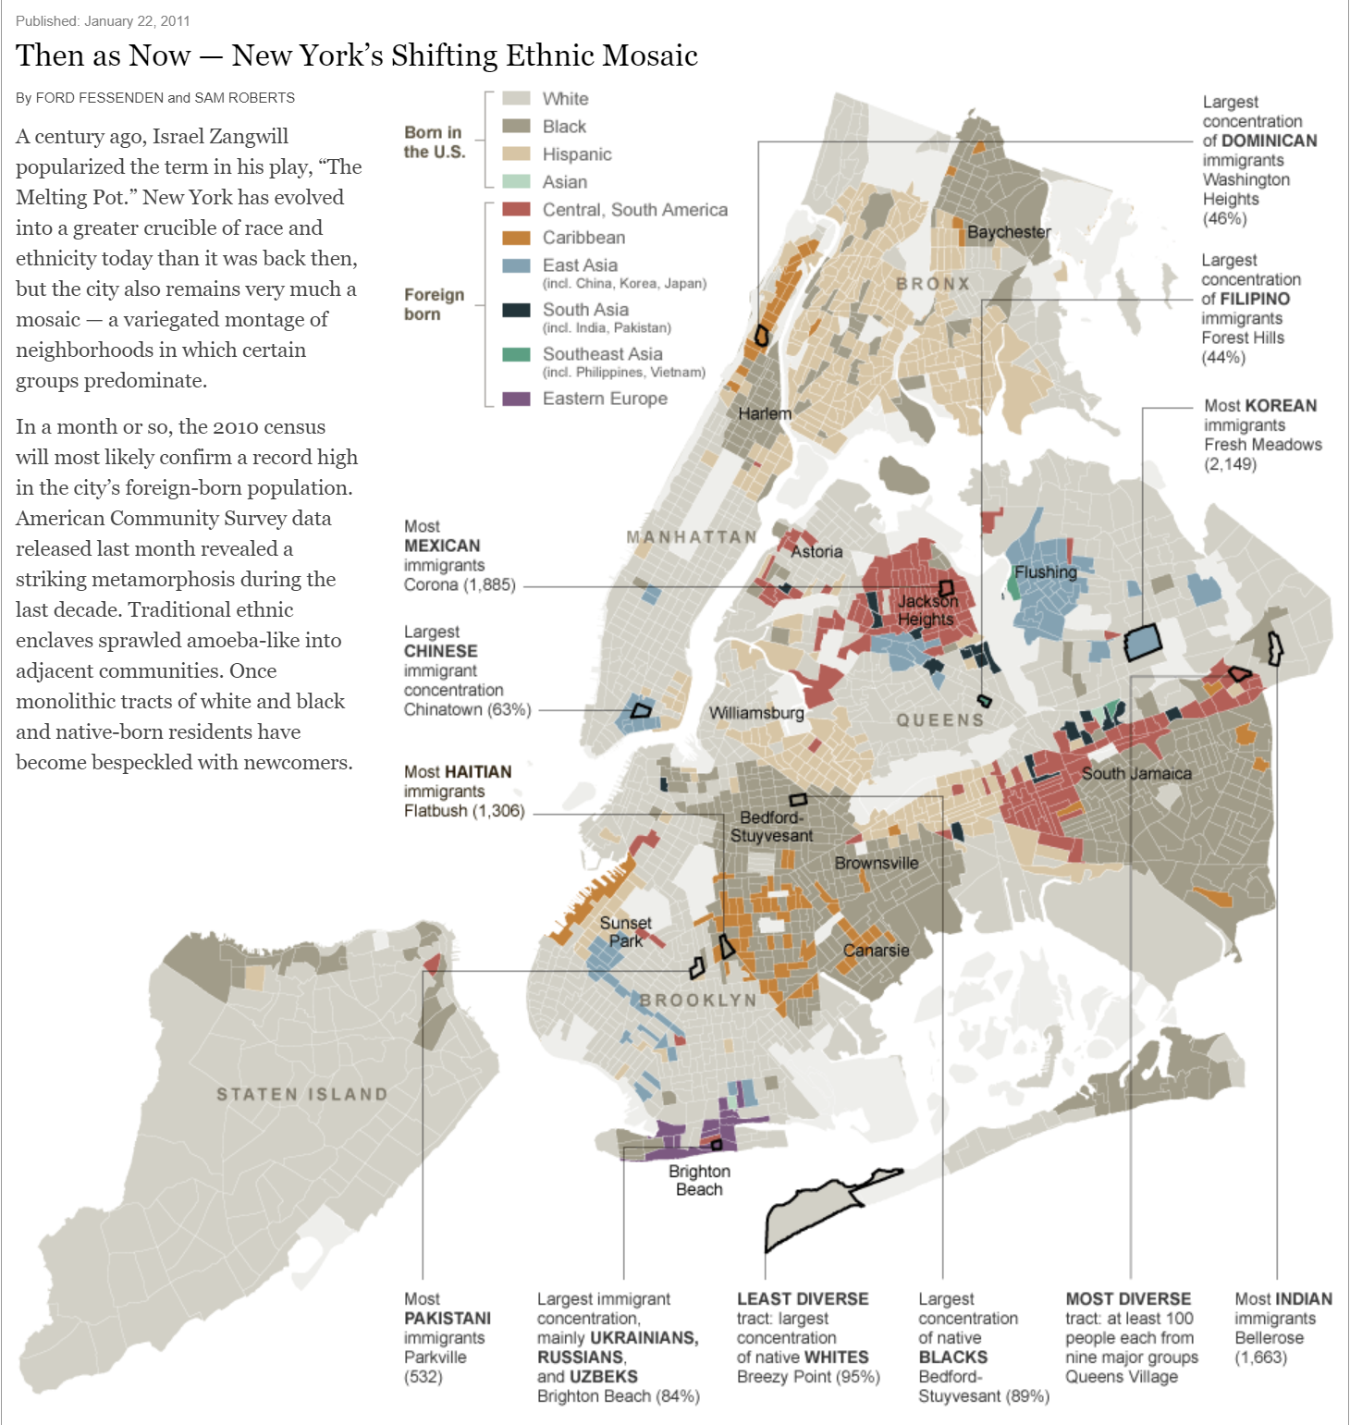
Proxy
Neighborhood as proxy for race
http://archive.nytimes.com/www.nytimes.com/interactive/2011/01/23/nyregion/20110123-nyc-ethnic-neighborhoods-map.html?_r=1

Slide 24

Sample size diversity
Used by Kodak to calibrate early color films. Very small sample without diversity.

Slide 25
Fairness definitions

Slide 26
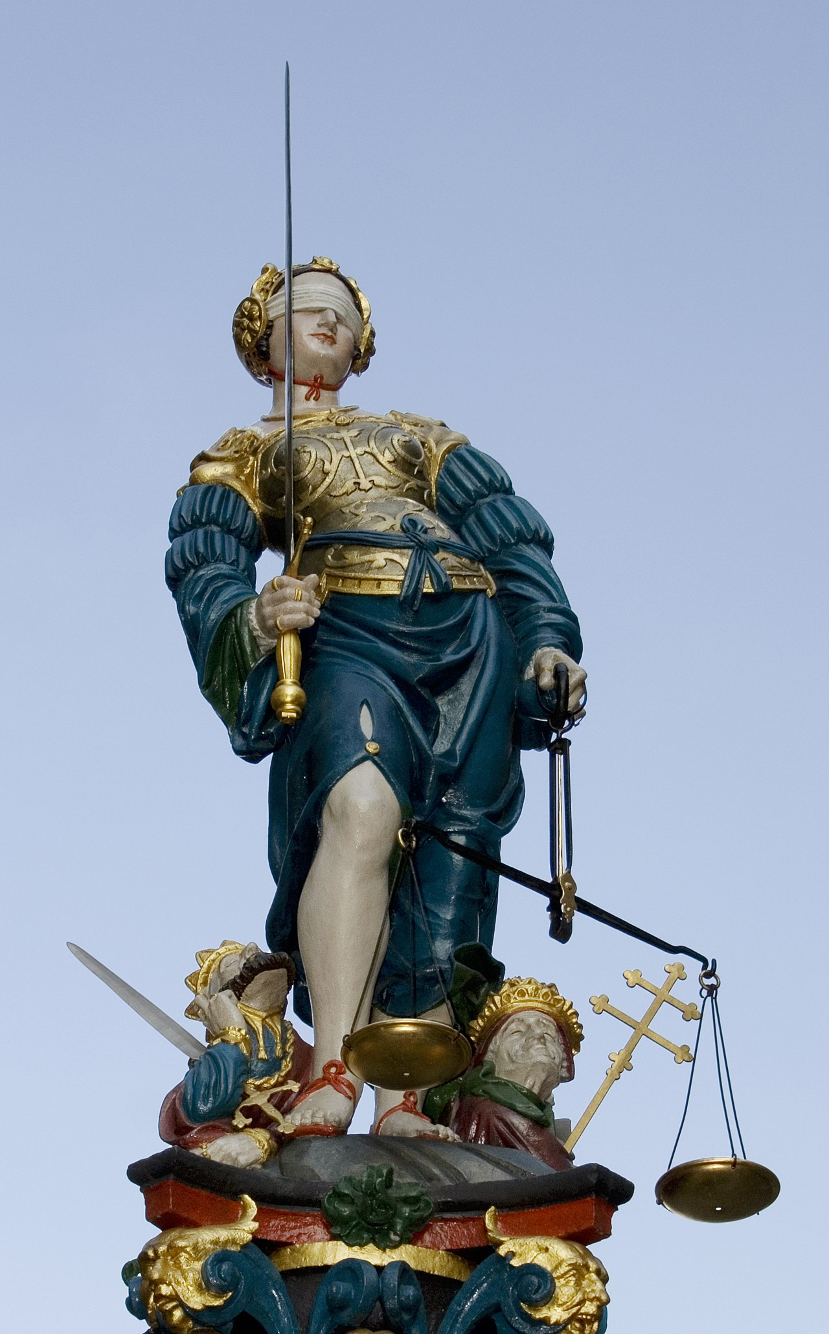
Anti-classification
Also known as fairness through blindness
Concept
Ignore sensitive feature when making a decision
Examples
Remove gender and race from credit scoring model
Limitations
Sensitive attributes may be correlated with other features
Some ML tasks need sensitive attributes (e.g., medical diagnosis)
https://de.wikipedia.org/wiki/Rechtspflege#/media/Datei:Berner_Iustitia.jpg

Slide 27
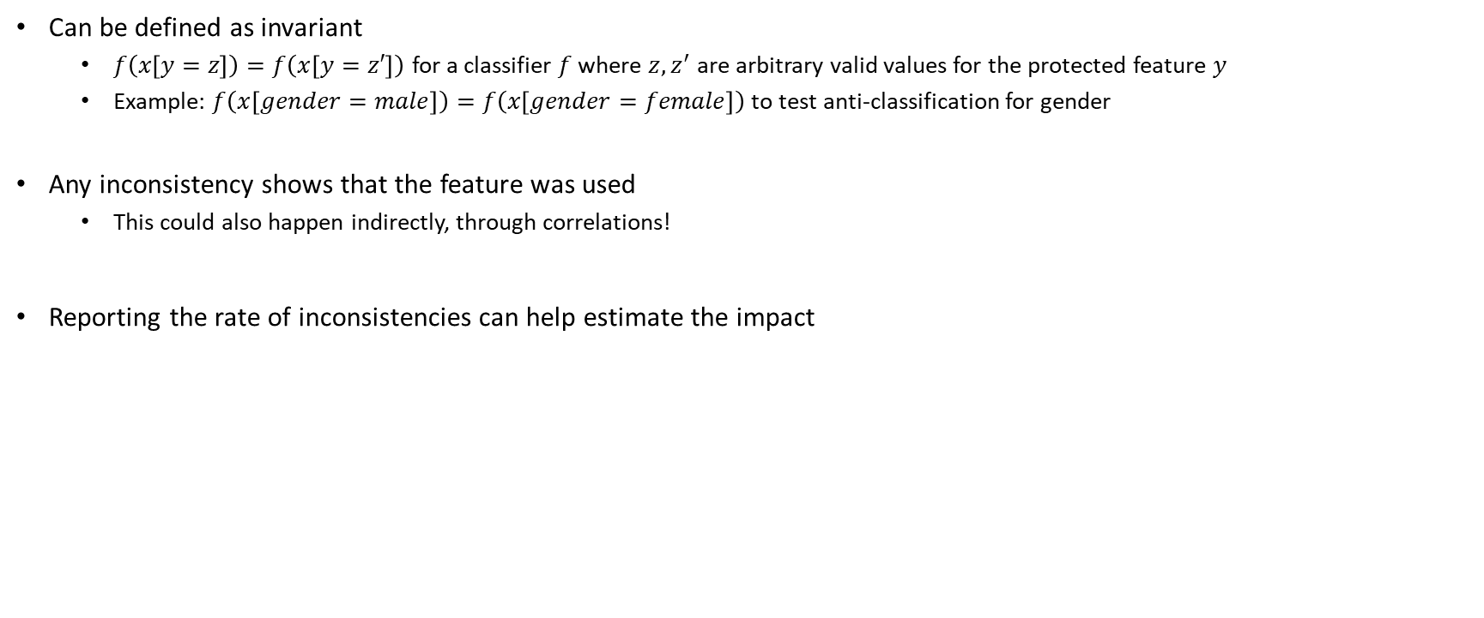
Testing anti-classification
Can be defined as invariant
$f\left(x\left[y=z\right]\right)=f\left(x\left[y=z′\right]\right)$ for a classifier $f$ where $z, z^{′}$ are arbitrary valid values for the protected feature $y$
Example: $f\left(x\left[gender=male\right]\right)=f\left(x\left[gender=female\right]\right)$ to test anti-classification for gender
Any inconsistency shows that the feature was used
This could also happen indirectly, through correlations!
Reporting the rate of inconsistencies can help estimate the impact
$x[y=z]$ denotes that the feature $y$ of the instance $x$ is set to $z$ without changing any other feature
$x.y$ denotes the value of feature $y$ of the instance $x$
See for example: Galhotra, Sainyam, Yuriy Brun, and Alexandra Meliou. "Fairness testing: testing software for discrimination." In Proceedings of the 2017 11th Joint Meeting on Foundations of Software Engineering, pp. 498-510. 2017.

Slide 28
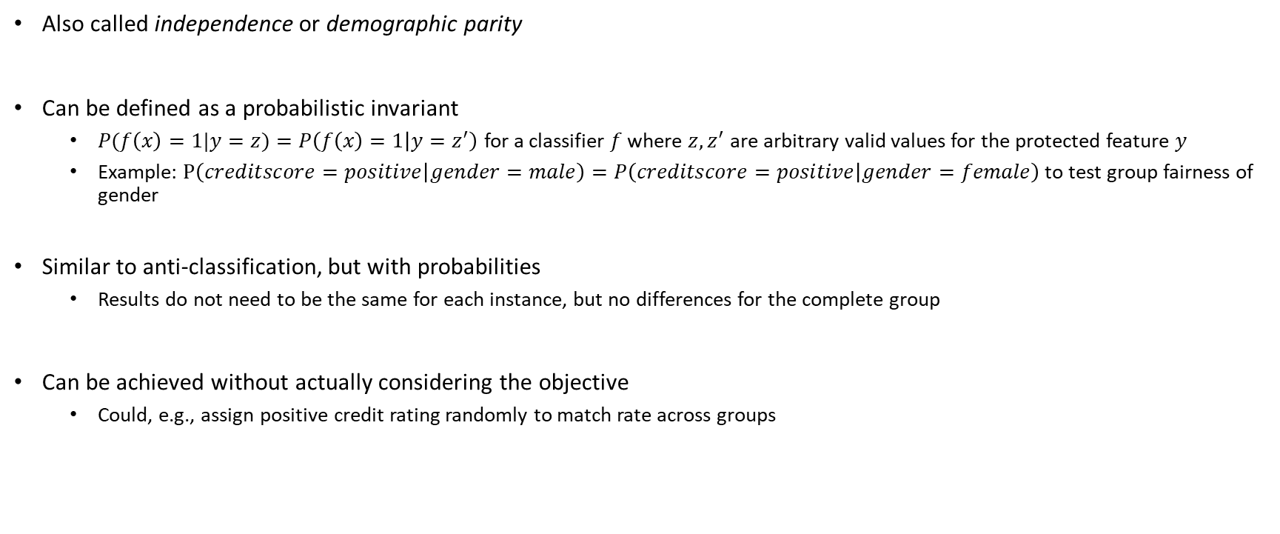
Group fairness
Also called independence or demographic parity
Can be defined as a probabilistic invariant
$P(f\left(x\right)=1|y=z)=P\left(f\left(x\right)=1 | y=z^{′}\right)$ for a classifier $f$ where $z, z^{′}$ are arbitrary valid values for the protected feature $y$
Example: $P\left(creditscore=positive | gender=male\right)=P\left(creditscore=positive | gender=female\right)$ to test group fairness of gender
Similar to anti-classification, but with probabilities
Results do not need to be the same for each instance, but no differences for the complete group
Can be achieved without actually considering the objective
Could, e.g., assign positive credit rating randomly to match rate across groups

Slide 29
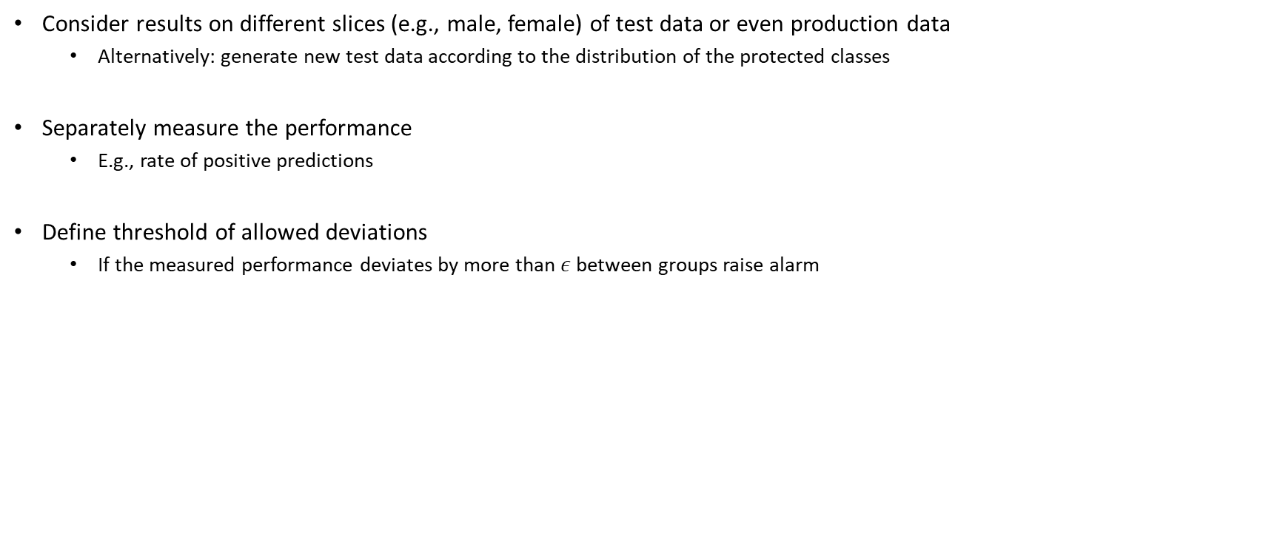
Testing group fairness
Consider results on different slices (e.g., male, female) of test data or even production data
Alternatively: generate new test data according to the distribution of the protected classes
Separately measure the performance
E.g., rate of positive predictions
Define threshold of allowed deviations
If the measured performance deviates by more than $ε$ between groups raise alarm

Slide 30
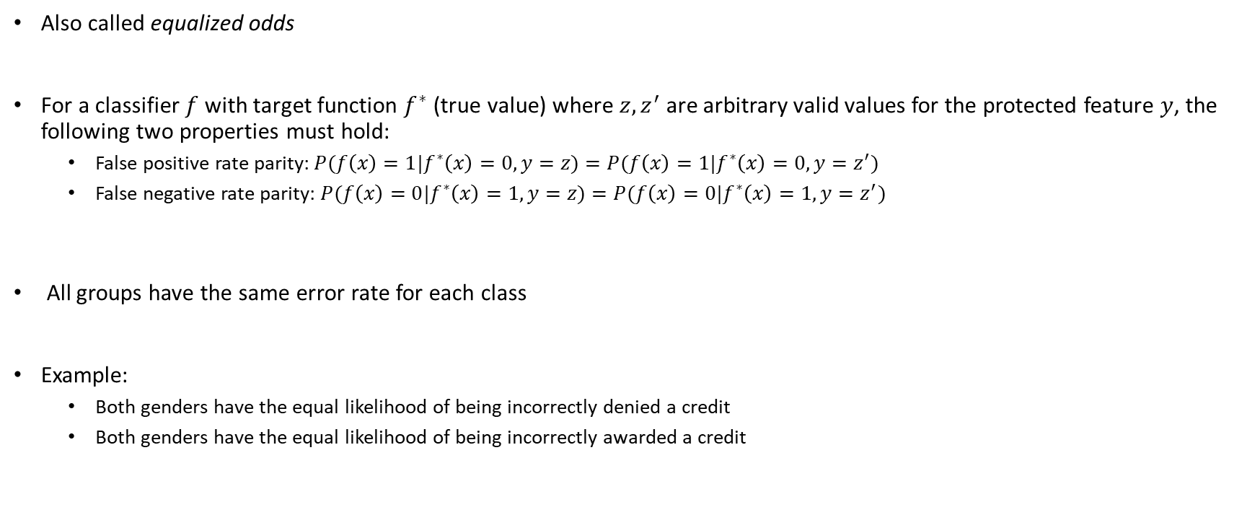
Separation
Also called equalized odds
For a classifier $f$ with target function $f^{∗}$ (true value) where $z, z^{′}$ are arbitrary valid values for the protected feature $y$, the following two properties must hold:
False positive rate parity: $P(f\left(x\right)=1|f^{∗}\left(x\right)=0, y=z)=P(f\left(x\right)=1|f^{∗}\left(x\right)=0, y=z^{′})$
False negative rate parity: $P(f\left(x\right)=0|f^{∗}\left(x\right)=1, y=z)=P(f\left(x\right)=0|f^{∗}\left(x\right)=1, y=z^{′})$
All groups have the same error rate for each class
Example:
Both genders have the equal likelihood of being incorrectly denied a credit
Both genders have the equal likelihood of being incorrectly awarded a credit

Slide 31
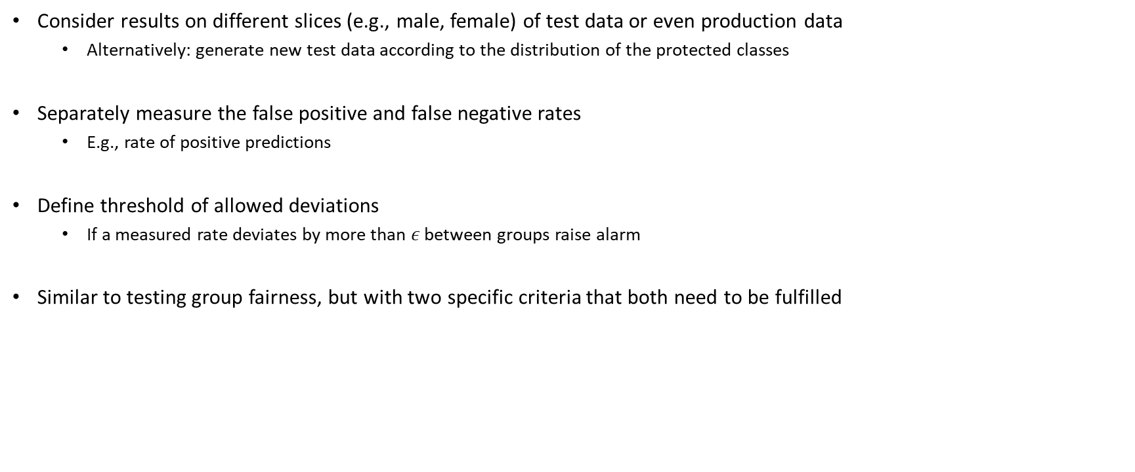
Testing separation
Consider results on different slices (e.g., male, female) of test data or even production data
Alternatively: generate new test data according to the distribution of the protected classes
Separately measure the false positive and false negative rates
E.g., rate of positive predictions
Define threshold of allowed deviations
If a measured rate deviates by more than $ε$ between groups raise alarm
Similar to testing group fairness, but with two specific criteria that both need to be fulfilled

Slide 32
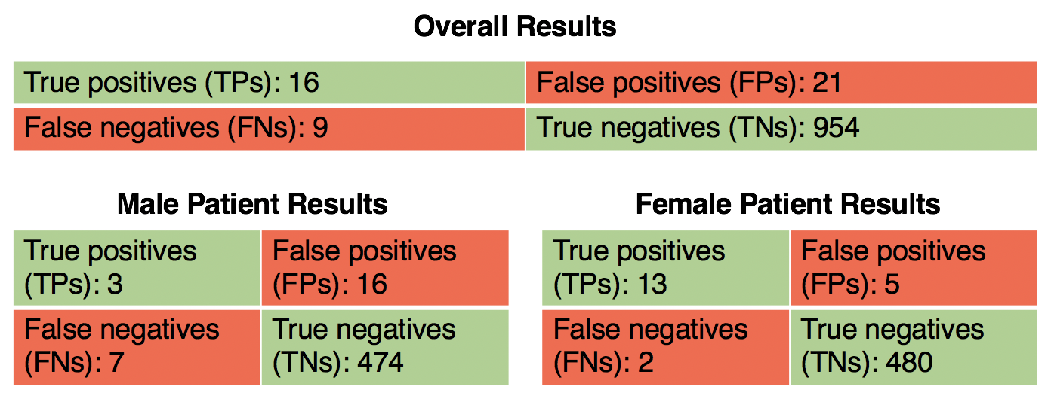
Live exercise: Is this cancer classifier fair?

Slide 33
Achieving fairness

Slide 34
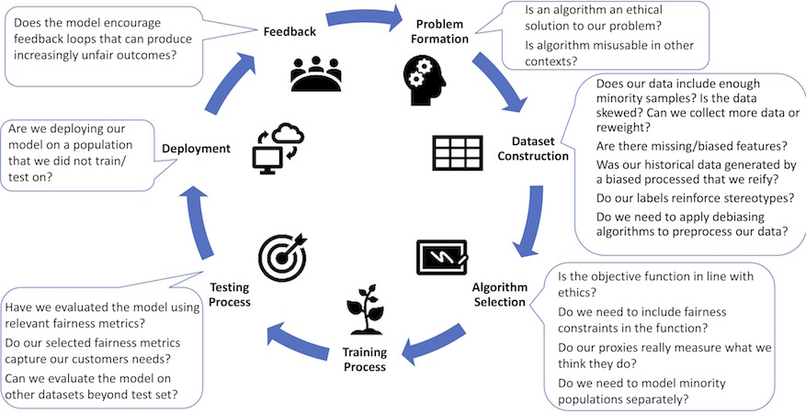
Fairness throughout the lifecycle
Fairness-aware Machine Learning, Bennett et al., WSDM Tutorial (2019).

Slide 35
Challenges for achieving fair systems
Fairness is a system-level property
Consider goals, user interaction design, data collection, monitoring, model interaction, …
Fairness-aware data collection and fairness testing for training data
Identifying blind spots
Proactive vs. reactive
Team bias and checklists
Fairness auditing processes and tools
Diagnosis and debugging
Outliers? Systemic problems? Causes?
Guiding interventions
Adjust goals? More data? Better data? Side effects? Redesign?
Assessing bias of humans in the loop
All of this costs money, which means we need (strong!) incentives for fairness!
Holstein, Kenneth, Jennifer Wortman Vaughan, Hal Daumé III, Miro Dudik, and Hanna Wallach. "Improving fairness in machine learning systems: What do industry practitioners need?" In Proceedings of the 2019 CHI Conference on Human Factors in Computing Systems, pp. 1-16. 2019.

Slide 36
Transparency

Slide 37
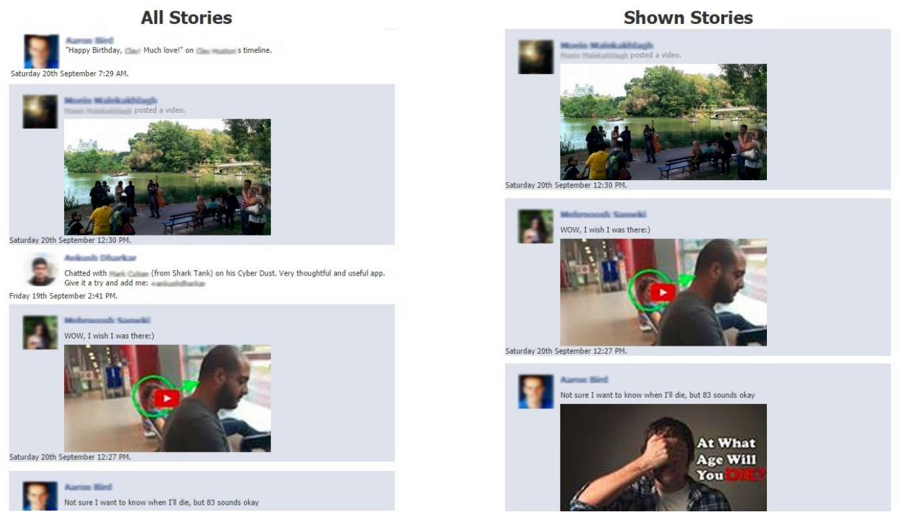
Example: Facebook‘s feed curation
62% of people interviewed were not aware that there is a curation algorithm
Many were surprised and angry when learning about this
“Participants were most upset when close friends and family were not shown in their feeds […] participants often attributed mussing stories to their friends‘ decisions to exclude them rather to Facebook News Feed algorithm”
Learning about the algorithm did not change the satisfaction level
More active engagement and more feeling of control desired
Eslami, Motahhare, Aimee Rickman, Kristen Vaccaro, Amirhossein Aleyasen, Andy Vuong, Karrie Karahalios, Kevin Hamilton, and Christian Sandvig. I always assumed that I wasn't really that close to [her]: Reasoning about Invisible Algorithms in News Feeds. In Proceedings of the 33rd annual ACM conference on human factors in computing systems, pp. 153-162. ACM, 2015.

Slide 38
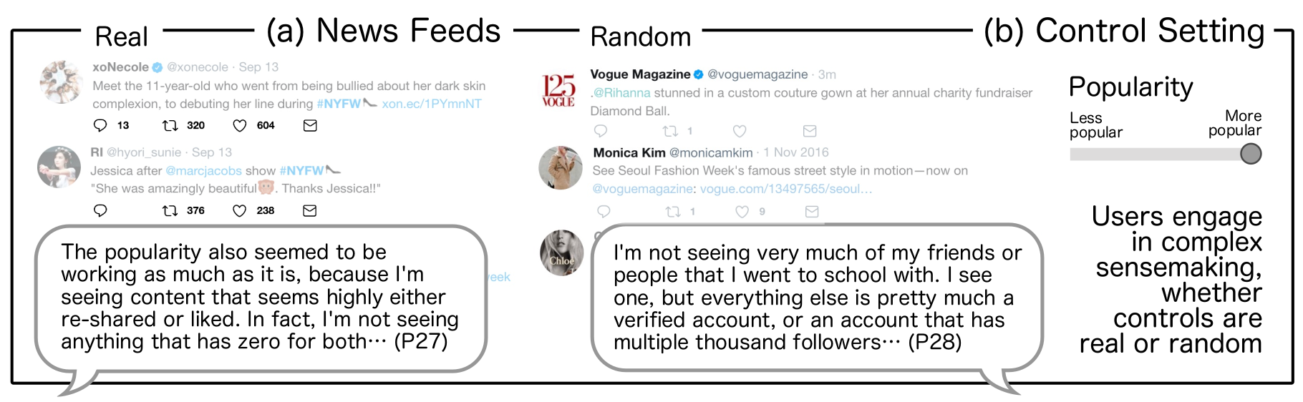
Useful transparency is difficult
User may feel influence and control, even if controls are only placebo controls (no real effect)
Companies often only give vague or generic explanations to appease regulators
Vaccaro, Kristen, Dylan Huang, Motahhare Eslami, Christian Sandvig, Kevin Hamilton, and Karrie Karahalios. "The illusion of control: Placebo effects of control settings." In Proc CHI, 2018.

Slide 39
Level of transparency
Transparency has side effects
Intellectual property
Trade secrets
Fairness
Perceptions
Ethics
Privacy
…
How to determine the level of transparency? How to design the system? How much control should be given?

Slide 40
Live exercise: Attacking models through explanations
Would a detailed explanation of how a results was achieved help to hack the model?
Loan applications
Unlocking mobile phones with a face scan
Automatic grading
Cancer diagnosis
Spam detection

Slide 41
Weak proxies as problem
Attackable models often use weak proxy features
Protections require to make the model hard to observe (e.g., expensive to query)
Similar to security by obscurity
Transparency is the opposite!

Slide 42
Human oversight and appeals
Unavoidable that ML models will make mistakes
Informing users about this may not comfort them
Imagine a bank telling you that they may falsely reject the loan for your dream house with 5% probability
Often not possible to appeal

Slide 43
Can humans in the loop help?
… if ML is used because human decisions are the bottleneck that should be reduced/removed?
… if ML is used because human decisions are biased and inconsistent?
… if ML is used because the data is extremely complex and hard to understand for humans?
Human in the loop may cause more problems than it solves!

Slide 44
Designing human oversight
Consider entire system and consequences of mistakes
Deliberately design mitigation strategies for handling mistakes
Consider keeping humans in the loop while balancing harms and costs
Determine possible pathways for appeals and complaints, as well as how to respond
Determine possibility to review ML decisions and how they may be overridden by humans
Track telemetry data to enable investigation of (common and uncommon) mistakes
Consider if auditing models and decision process is a better choice than an appeals process

Slide 45
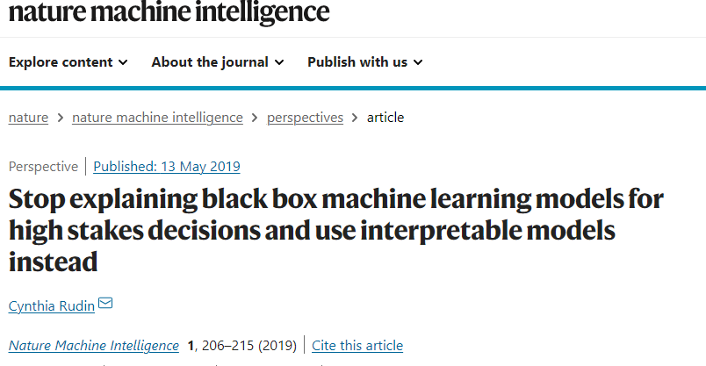
Call for transparent and audited models
High stakes decisions with government involvement (e.g., recidivism, policing, city planning)
High stakes decisions in medicine (e.g., treatments)
High stakes decisions with discrimination concerns (e.g., hiring, loans, housing)
Decisions that influence society and discourse (e.g., content curation, targeted advertisement)
No black box should be deployed when there exists an interpretable model with the same level of performance
Rudin, Cynthia. "Stop explaining black box machine learning models for high stakes decisions and use interpretable models instead." Nature Machine Intelligence 1.5 (2019): 206-215.

Slide 46
Accountability

Slide 47
Terminology
Accountability, responsibility, liability, and culpability all overlap in common use
All about assigning blame and responsibility for fixing something or paying for damages
Liability and culpability have a legal connotation
You may be liable for damages because you are held culpable for a problem
Accountability and responsibility rather tend to descript ethical aspirations
Similar to “legal vs. ethical” discussed at the beginning of this chapter

Slide 48
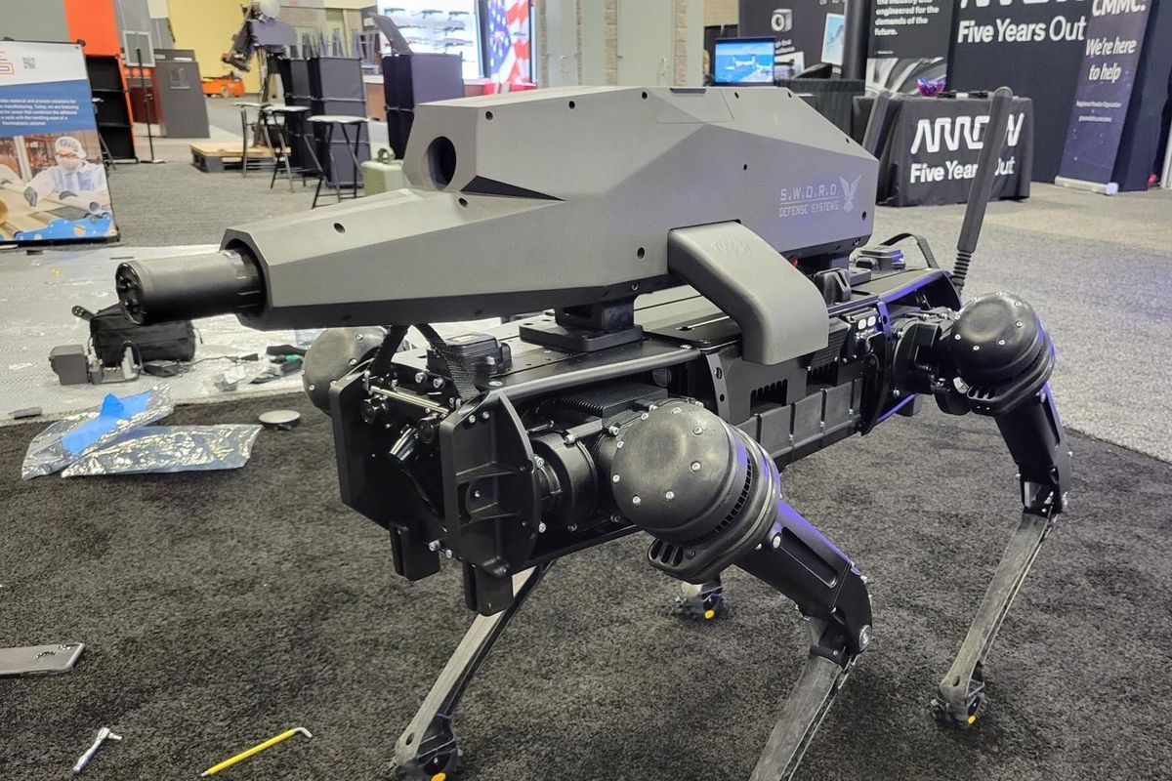
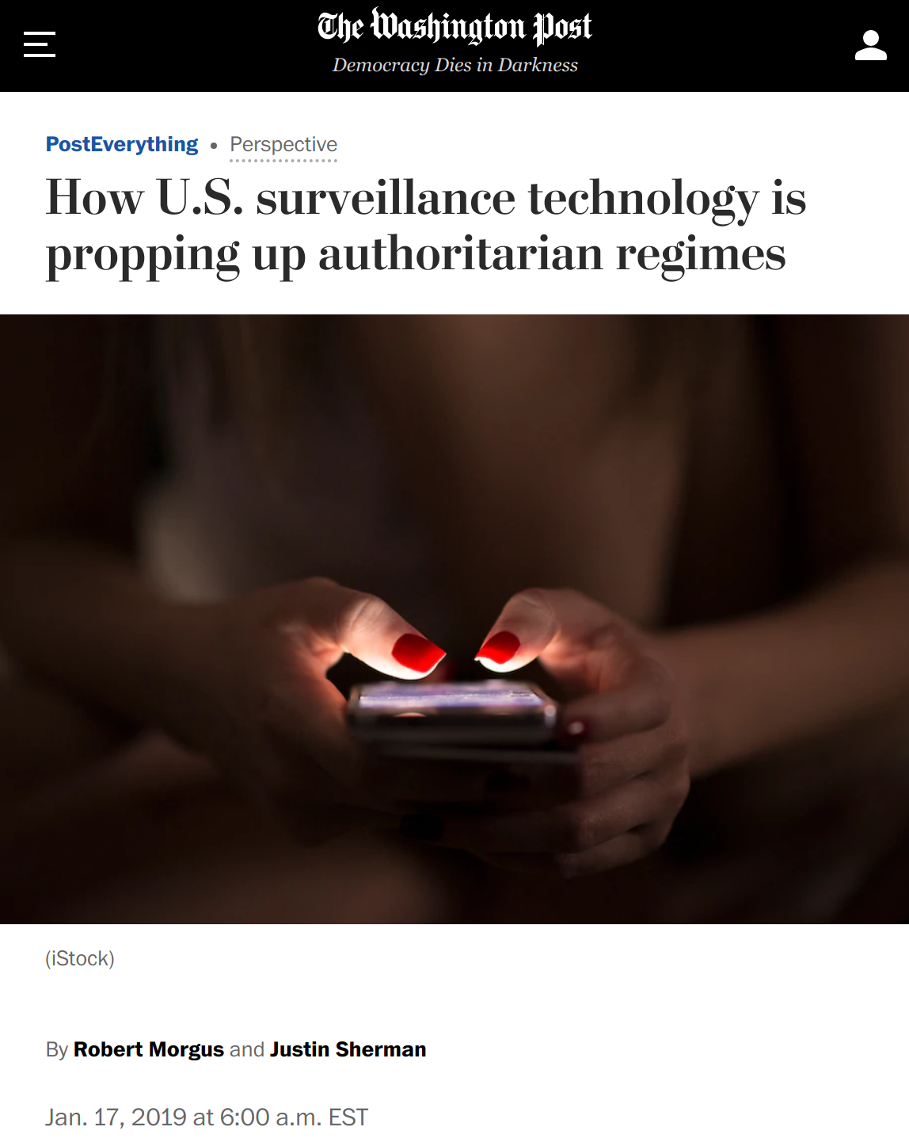
Who is responsible?
https://www.theverge.com/2021/10/14/22726111/robot-dogs-with-guns-sword-international-ghost-robotics
https://leftronic.com/blog/social-media-addiction-statistics/

Slide 49
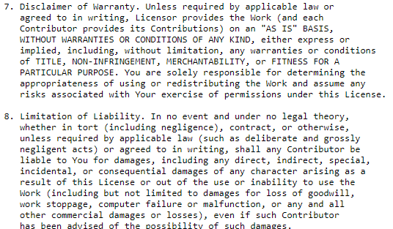
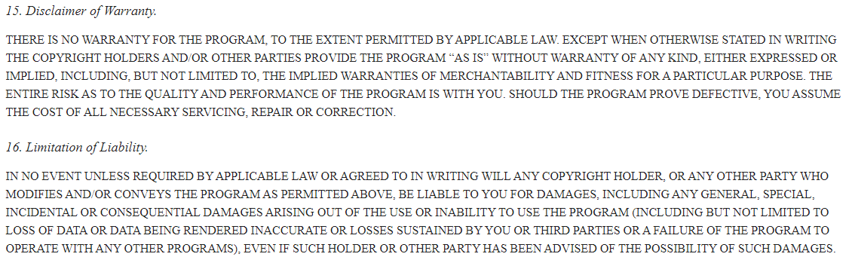
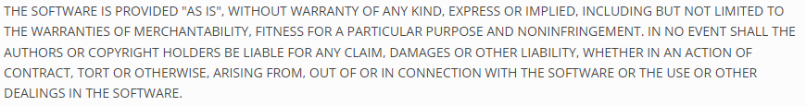
How software engineers usually handle this …
GPL 3.0
Apache License 2.0
MIT License

Slide 50

Easy to blame “The Algorithm” / “The Data” / “Software
But the system was designed by humans
Humans did not anticipate possible mistakes and did not design mitigations
(or they did not care about them…)
Humans made decisions about what level of quality assurance is sufficient
Humans designed (or ignored) the process for developing the software
Humans gave/sold poor quality software to other humans
Humans used software without understanding it
…
It‘s just a bug! Such things happen and we can do nothing about it.

Slide 51
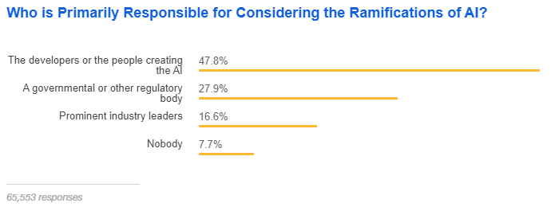
Developers think that they are responsible …
https://insights.stackoverflow.com/survey/2018/#technology-and-society

Slide 52
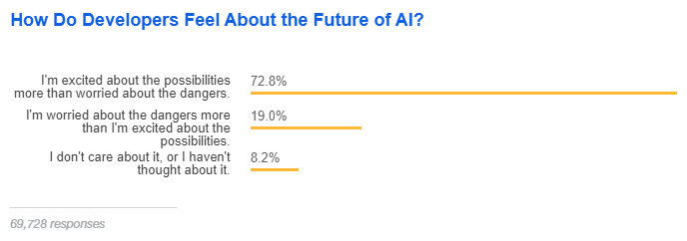
… but still excited!
https://insights.stackoverflow.com/survey/2018/#technology-and-society

Slide 53
What to do?
Responsible organizations embed risk analysis, quality control, and ethical considerations into their process
Establish and communicate policies defining responsibilities
Work from aspirations toward culture change
Baseline awareness for everyone supported by experts
Document tradeoffs and decisions
Consider controlling/restricting how software may be used
And follow the law …
Possible starting point:
https://algorithmwatch.org/en/ai-ethics-guidelines-global-inventory/

Slide 54
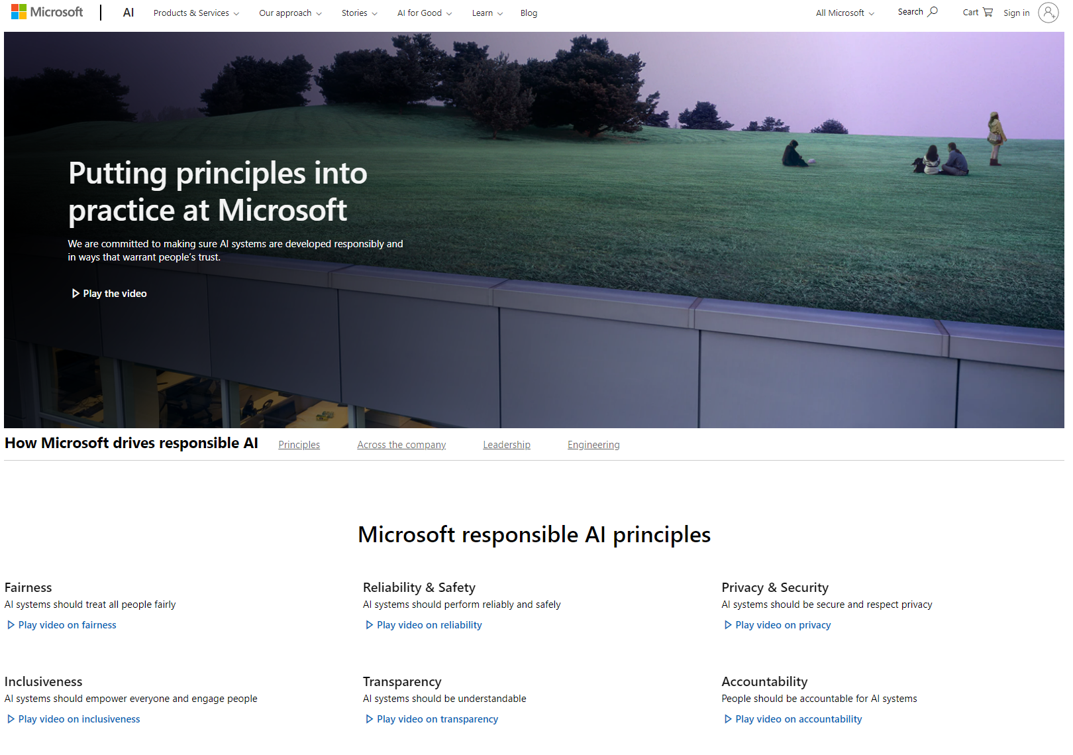
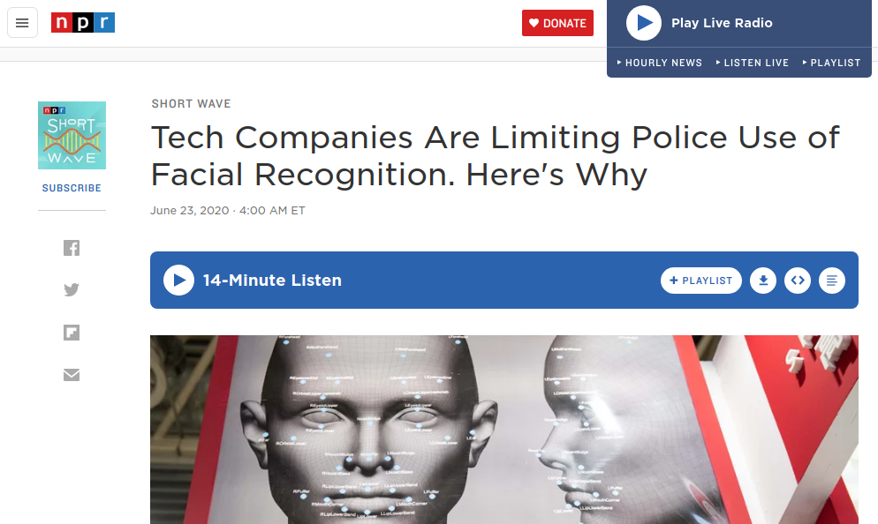
Self-regulation in practice
https://www.npr.org/2021/02/17/968710172/why-tech-companies-are-limiting-police-use-of-facial-recognition?t=1658309672028
https://www.microsoft.com/en-us/ai/our-approach

Slide 55

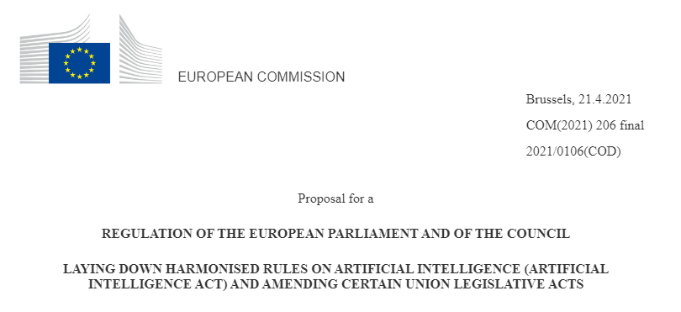
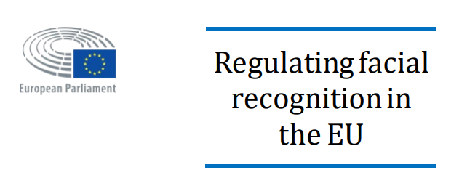
Government regulation
(on the other hand, China requires state control over valuable data…)
https://digital-strategy.ec.europa.eu/en/library/ethics-guidelines-trustworthy-ai
https://www.europarl.europa.eu/RegData/etudes/IDAN/2021/698021/EPRS_IDA(2021)698021_EN.pdf
https://eur-lex.europa.eu/legal-content/EN/TXT/?uri=CELEX:52021PC0206

Slide 56

Questions?

